Slide 1


Sealed System Training Handout
Training Academy

Slide 2
Verify Complaint
Customer or
Environmental Issue
Demonstrate to the customer proper operation / usage.
Appliance Issue
Establish Repair Direction.
Sealed System Related
Inefficient Compressor
Leak
Restriction
Mechanical
Failed fan bearing
Failed rails
Failed seals
Stuck damper
Inoperable mullion
Electrical
Open fan motor
Failed IPM
Failed PCB
Sensor Failure
Defrost Failure
Successful Repair

Slide 3
Process Changes and Improvements
Added:
Verify the 3-way valve is in the home “all” setting, prior to disconnecting the 3-way valve jig, also verify the factory harness has been reinstalled on the 3-way valve
Changed:
Checking for contamination (Previously split the dryer and check)
  Once the compressor/drier is removed, using a quick connect send nitrogen from the drier end of the Yoder loop through the Yoder and out the condenser end watching for contamination, if contamination is found, flush with RX-11
Yoder Loop Testing
  units made before 2020, that have a high side leak or an inefficient compressor, pressurize the Yoder and check for leaks
Flushing
  If contamination is found, use RX-11 (not refrigerant) according to safety policy to flush the Yoder loop and cap tube if the cap tube can not be cleaned replace it.
Vacuum
  Run your vacuum pump until 500 microns are reached, then allow the pump to run an addition 10 minutes, before charging.
  If 500 microns can not be reached, determine the cause, and correct the issue.
Charging
  R600a Utilize the single can method, by releasing excessive refrigerant outdoors, to achieve the required charge.
  R134a Charge on the low side using vapor.

Slide 4
Process |  | Steps | Why | Details | Example
Diagnosis Poor Cooling If the unit is not cooling at all, use the next page for "NO COOL" | 1 | Interview customer/Product and home inspection | Doing this can help diagnose the failure and a better understanding of what happened | Ask open ended questions and try different ways to approach the customer. | How long was the refrigerator down for? Did you reset the power? What attempts did the customer do to correct the failure?
 |  |  | To protect you and LG against false accusations | Point out and take a photo of any visible damage prior to moving the unit | Sir you are aware your unit has a dent, here in the freezer door and your tiles are cracked? Snap a picture and attach
 |  |  | Verify Model and Serial Number for warranty purposes, attach to the service order. | Verify you are working on the correct unit and or order, if there is a discrepancy, correct the mistake. | If you have the incorrect model info you may have ordered the incorrect parts.
 | 2 | Collect temperature data. Verify Customer Settings | Verifies complaint. | Freezer, Refrigerator, Ice maker room and custom drawers. | Notes Example FZ - 0, R - 37, IM - 5
 |  |  | Verifies the poor cooling is not caused by incorrect settings.
 |  |  | Will be required if contact will TCC is required and should be included in your notes.
 |  |  | R600a- For safety reasons, if warmer than normal temperatures are discovered, check the area, with your combustible leak detector for any combustible refrigerant. | R600a is heavier than air and can settle down around the lower portion of the unit. | Scan the lower area of the compressor room with your combustible leak tester. If refrigerant is detected take safety actions using a fan and open windows
 | 3 | Check for hidden error codes. | Checks for possible failures that may result in reclaim. | Press and hold Freezer and Ice Plus and release if all 88s come up, indicating no stored error. | Intermittent fans fan or sensor errors may clear prior to displaying to the customer.
 |  |  | Checks for possible other causes for poor |  | Pre-existing errors like IT E may be present but not displayed.
 | 4 | Measure and record household supply voltage, compressor voltages and amperage. Check for main board blink codes. | Supply voltage - Rule of thumb: with in 5% of rated amount | Source voltage, compressor voltages and blink codes should be checked at the board. | 118v at wall
 |  |  | Voltages outside normal range indicate issues, could be environmental or sealed system. |  | 350V is a clear indication of a problem
 |  |  | Blink codes indicates the main board detected problem. |  | 3 blinks indicates open winding in the compressor or a disconnect between the compressor and main board
 |  |  | Will be required if contact will TCC is required and should be included in your notes. |  | Notes:180v .6amps
 | 5 | Visually inspect evaporators for frost pattern. | Poor frost patterns indicate sealed system issues. | Incomplete frost pattern or frost that won't make it back to the suction line indicates a problem. Corrosion on copper tubing is an indication of a long-time leaking evaporator. | 6" of frost on the inlet/cap tube is a problem A complete frost pattern may mean the sealed system is ok.
 |  |  | A solid frost pattern may indicate the problem is elsewhere, unless the unit went thru a period of unexplained cooling. | A complete frost pattern may mean the sealed system is ok. | Frost pattern from cabinet to cabinet indicates a full frost pattern.
 |  |  | Evaporator condition should be included in your notes. | FP=full FP=poor | Notes example: Poor Frost Pattern, Good Frost Pattern
 |  | Fresh Food Evaporators Inspection | POE oil creates an acid when exposed to moisture | indicates leaking | Look for evidence of corrosion, un-even discoloration, UV Dye (if present), areas of rust or pitting especially near the argon weld

Slide 5
Process |  | Steps | Why | Details | Example
No Cool | 1 | Interview customer/Product and home inspection | Doing this can help diagnose the failure and a better understanding of what happened | Ask open ended questions and try different ways to approach the customer. | How long was the refrigerator down for? Did you reset the power? What attempts did the customer do to correct the failure?
 |  |  | To protect you and LG against false accusations | Point out and take a photo of any visible damage prior to moving the unit | Sir you are aware your unit has a dent, here in the freezer door and your tiles are cracked? Snap a picture and attach
 |  |  | Verify Model and Serial Number for warranty purposes, attach to the service order. | Verify you are working on the correct unit and or order, if there is a discrepancy, correct the mistake. | If you have the incorrect model info you may have ordered the incorrect parts.
 | 2 | Collect temperature data. Verify Customer Settings | Verifies complaint. | Freezer, Refrigerator, Ice maker room and custom drawers. | Notes Example FZ - 0, R - 37, IM - 5
 |  |  | Verifies the poor cooling is not caused by incorrect settings.
 |  |  | Will be required if contact will TCC is required and should be included in your notes.
 |  |  | R600a- For safety reasons, if warmer than normal temperatures are discovered, check the area, with your combustible leak detector for any combustible refrigerant. | R600a is heavier than air and can settle down around the lower portion of the unit. | Scan the lower area of the compressor room with your combustible leak tester. If refrigerant is detected take safety actions using a fan and open windows
 | 3 | Check for hidden error codes. | Checks for possible failures that may result in reclaim. | Press and hold Freezer and Ice Plus and release if all 88s come up, indicating no stored error. | Intermittent fans fan or sensor errors may clear prior to displaying to the customer.
 |  |  | Checks for possible other causes for poor |  | Pre-existing errors like IT E may be present but not displayed.
 | 4 | Measure and record household supply voltage, compressor voltages and amperage. Check for main board blink codes. | Supply voltage - Rule of thumb: with in 5% of rated amount | Source voltage, compressor voltages and blink codes should be checked at the board. | 118v at wall
 |  |  | Voltages outside normal range indicate issues, could be environmental or sealed system. |  | 350V is a clear indication of a problem
 |  |  | Blink codes indicates the main board detected problem. |  | 3 blinks indicates open winding in the compressor or a disconnect between the compressor and main board
 |  |  | Will be required if contact will TCC is required and should be included in your notes. |  | Notes:180v .6amps
 | 5 | Visually inspect evaporators for frost pattern. | Poor frost patterns indicate sealed system issues. | Incomplete frost pattern or frost that won't make it back to the suction line indicates a problem. Corrosion on copper tubing is an indication of a long-time leaking evaporator. | 6" of frost on the inlet/cap tube is a problem A complete frost pattern may mean the sealed system is ok.
 |  |  | A solid frost pattern may indicate the problem is elsewhere, unless the unit went thru a period of unexplained cooling. | A complete frost pattern may mean the sealed system is ok. | Frost pattern from cabinet to cabinet indicates a full frost pattern.
 |  |  | Evaporator condition should be included in your notes. | FP=full FP=poor | Notes example: Poor Frost Pattern, Good Frost Pattern
 |  | Fresh Food Evaporators Inspection | POE oil creates an acid when exposed to moisture | indicates leaking | Look for evidence of corrosion, un-even discoloration, UV Dye (if present), areas of rust or pitting especially near the argon weld

Slide 6
Process |  | Steps | Why | Details | Example
Tapping and reading the pressures | 6 | Tap both sides of the system and evaluate the system. | Pressures above normal or below normal may give a clear indication of a problem. | With only one side of the system tapped we cannot properly evaluate a sealed system issue. The high side reading can tell us where the problem is, provided the compressor is good. Both pressures are needed to see how long the unit takes to equalize. | L-3 H30 EQ 5mins
 |  |  | Will be required if contact will TCC is required and should be included in your notes.
Disassembly Checking for sealed system contamination | 7 | Recover, and disassemble the sealed system. Reminder: Always home the 3way valve to the all position, prior to recovery on dual evaps systems. | Find the leak, if possible, prior to disassembly. | Pressurize with nitrogen if high side leak is suspected, then bubble check the high side joints looking for a leak prior to disassembly. | Pressures on both high and low side are lower then normal, remove the refrigerant, add nitrogen, and bubble check, or add refrigerant and inspect for leaks.
 |  |  | R134a must be recovered as per EPA requirements. | Recover R134a via recovery process. | Recover using a recovery machine and recovery tank.
 |  |  | R600a should not be released in the home for safety reasons. | Safely remove the refrigerant, and release outdoors. | Recover R600a in a recovery bag and release it outdoors.
 |  |  | Gain access to internal tubing to check for leaks and restrictions. | Remove the compressor and drier, be mindful of how the new compressors will be installed and remove accordingly. Plan ahead for Lokring use. | Cut the suction line from the compressor as close as possible as Lokring will be used to reassemble the unit.
 |  |  |  | 2020 or older units need to have the Yoder loop checked for leaks | L-15, H80 EQ 5min
 | 8 | Inspecting internal tubing for contamination Replaced condenser when contamination is found and flush Yoder. | Check the oil condition. | Dark oil indicates there is a lot of contamination of the sealed system. | Tilt the compressor allowing a small amount of oil flow on to a paper towel. Compare the color to the compressor chart.
 |  |  | Inspections of the system can provide clues as to what the root cause of the failure was. | Using quick connect and Nitrogen purge Yoder from drier side back to condenser checking for contamination | flushing is required if contamination is found

Slide 7
Process |  | Steps | Why | Details | Example
Flushing and cleaning | 9 | Flushing and checking pipes for correct flow R134a systems always flush the yoder and cap R600a if contamination is found flush yoder (For dual evap systems must use the 3-way jig to clear both caps) | Debris left behind in system can cause future failures. | Liquid flush with RX11 the yoder loop and cap tube. If the cap tube can not be cleaned, it should be replaced. | using the quick connects on both ends of the yoder loop. A 6 second column of RX11 is fed into the yoder, followed by 125psi of nitrogen will flush thru the system pushing out debris out to the recovery bag.
 |  |  | Restrictions not discovered will cause short term reclaim. | Flow checking will ensure the refrigerant will flow after the repair. | Using nitrogen to double check the tubing is open and free flowing. Feeding the cap tube 100psi and then watching the pressure drop, to test for coorect flow.
Reassembly | 10 | Reassemble with needed parts, checking for self inflicted restrictions as you go. | Replacing the needed componates, and testing the joints as you go, will help you prevent self inflicted restrictions. | Install components followed by testing for flow. | Start with installing the condenser to yoder and then check for flow, install an evaporator if needed then check for flow cap to suction line. Make sure you did not cause a restriction.
Total system flow check and leak check | 11 | Final flow check and pressure testing for leaks after the needed parts are installed. | This allows you to confim the drier and compressor connections are open, and then pressureize the system with nitrogen and a leak check on all joints can be performed. | Follow the refrigerant path with nitrogen from the compressor to the drier then from the drier to the compressor once flow is confirmed the system can now be pressureized and a bubble solution can be applied to check for leaking joints. | Check all tech made joints as well as factory joints on the dryer and condenser.
Charging | 12 | Vacuum and recharge | Make sure the 3 way is set to the "Home" or "All" prior to vacuuming, be sure to connect 3-way valve harness after service | error codes or improper temperature issues | RDH error or poor cooling/ too cold after repair
 |  |  | Vacuuming the system removes moisture from the sealed system. | Set up vacuum jig. Run Vacuum Pump to reach 500 microns and add an additional 10 minutes of vacuum time | Most cases vacuum time will be around 20 minutes. If cannot achieve 500 microns check for leakage or tool issue technician must determine cause. Maximum vacuum time will be 30 minutes.
 |  |  | Recharging the system insures proper cooling after the repair. | Recharge the unit using the single can method, and or charging R134a on the Lowside as a vapor. | Release the appropriate amount of R600a from the 90 gram can and then charge after vacuuming.
 |  |  | LQC mode will run the compressor at a steady speed allowing the compressor to draw in the R600a from the cap. LQC will also speed up the process of checking for heat. | To activate With in 10 minutes of powering on the unit: "Freezer or Lock” + Ice Plus or Express Freeze" PRESS AND HOLD Till it Beeps | "Freezer or Lock” + Ice Plus or Express Freeze" PRESS AND HOLD Till it Beeps

Slide 8
Process |  | Steps | Why | Details | Example
Update the compressor software if needed. | 13 | Connect the software update jig to the main board and perform the automatic update. | Some compressors replace other compressors, and an update is required | Connect the software update jig to the main board and perform the automatic update. Reference the correct bulletin to verify the update is correctly installed. | FLE165 is replaced by FLD165, and a software must be installed or the new FLD165 will not operate correctly.
 |  |  | In many cases the update will modify the compressor algorithm, to improve performance and compressor longevity.
Completing the repair | 14 | Double checking to help reduce reclaim | Always try to replicate what the factory did. If pipes are close to the cover be sure they will not cause noise and a return visit. | Adjust tubing or add foam and replace back cover. | eliminate noise complaints
 |  |  |  | Check operation of all fans, ice makers and noise level | fans and ice makers are operational, and sound level is acceptable
 |  |  |  | Clean the area and return the unit to its correct location. | Ask the customer if the unit is in the correct location. Verify 2" from the wall, advised on the requirement.
 |  |  |  | Press and hold Freezer and Ice Plus and release if all 88s come up, indicating no stored error. | If a fan or sensor was how disconnected, the error would take 3 hours to show but will show in hidden errors check.
 |  |  |  | Verify correct temperature settings. | CN may have asked the customer to set the unit to 33/-6 this may cause a fresh food to freeze
 |  |  |  | Set correct expectations | Advise the unit will take 24 hours to cool, minimal food for the next few days, should have ice tomorrow but craft ice make take 5 days
 |  |  |  | Check bins, shelfs and seals | Quickly check the bins and shelfs as the may have been removed for cleaning and incorrectly installed leading to the door not closing and frost forming shortly after your repair.
 |  |  |  | Be proud and leave your contact info. | Thank you for allowing me to service your unit, if you have any issues with your product or any LG product, please feel free to reach out to me.
 |  |  |  | Appliance use and care | Offer advise on the unit, offer water filters, and care instructions like opening the freezer 100% each week to keep the rails from freezing, explain what the fruit and veggie slider is for (humidity), bring our LG appliance up to a higher level, mention ThinQ if equipped.
 | 15 | Notes/Closing the call (Avoid cutting and pasting) | Notes help the next tech, your manager, TCC, the customer, TA, Reclaim Review | Solid notes are a must, they should include, temps, pressures, voltage/amperage, evap condition, the original complaint, a short explanation of what was performed, what parts were used and expectations | Unit has a pre-existing dent on the freezer door and the floor has several cracks in the tile, customer is aware of both, and pics have been attached. F-20 R-45 I-25, 138v .3 amps FP=poor. Customers complaint no ice, found inefficient FLE compressor, -3/30 unit EQ 5m. Replaced comp, drier, and cond. No indication of leaks or restrictions, cap tube is open, flushed Yoder and cap. VAC to 300microns, charged 56g R600a. Advised 24 hours for cooling, minimum food for 5 days. Replaced C-IM and updated main and comp software. Advised cust to connect to ThinQ. PC:03
 |  |  | Your receipt is a legal document. | You should include what you found, repaired and installed, any product or home defects should be listed and pictures attached. Model and serial picture should always be included.

Slide 9
1. Interview the customer, verify model/serial and inspect for product and home damages.
Verify the complaint
  How long was the refrigerator down for?
  Did you reset the power?
  What attempts did the customer do to correct the failure?
Pre-existing Damage
  Notate any product damages.
  Notate any property damages.
Environmental Conditions
  Pushed up against the wall?
  Exposed to extreme temperatures.
Verify model / serial tag
2. Getting Temperatures
Collect and record temps from the Refrigerator, Freezer and Ice Room.
Read the instructions for your tester to insure correct usage.
Test your equipment on your refrigerator to verify its accuracy.
Check Customer Control Settings.
When temperatures are higher then normal there is a possibility, the unit has a leak.
Best practice is to check around the base of the unit for any residual R600a using your electronic combustible refrigerant detector.
Temporarily stopping the condenser fan will help you to get a proper reading.

Slide 10
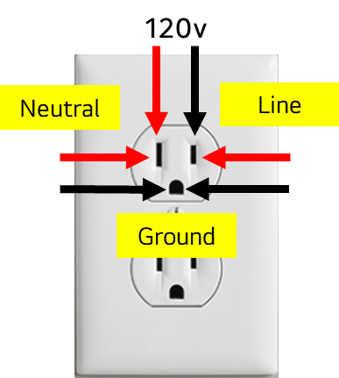
3. Hidden Errors
Press Freezer and Ice Plus.
Aways check on arrival and prior to leaving.
Non-critical error codes may never appear for the customer.
Critical error codes must be verified by the main board before displaying to the customer but will appear as a hidden error until verification is complete.
If the error clears prior to main board verification, the hidden error also clears.
Best practice is to ask the customer to press and hold Freezer and Ice plus on your prescreen call and release if all 8’s appear. (88:88)
On certain models, if Freezer and Ice Plus are held too long after 88:88 is displayed the unit may go into a compensation mode and display S:S or FS
4. Measure and record house voltage, compressor voltage and amperage & blink codes
Check for voltage and amperage on all compressors and check for blink codes
Always add your voltage/amperage readings to your notes.
On FLD, FLE and FMA compressors capture voltage readings from common-power and common-save.
3 Blinks indicates an open circuit.
2-wire linear & BLDC compressor 150-220VAC is considered normal
For a 3-wire linear compressor Common to Power=100-160VAC Common to Save=140-220VAC is considered normal
Higher or lower than normal voltage may indicate a problem.
Household voltage reading should be with in 5% of what is listed on the data plate.

Slide 11
Blink Codes
FCT0 Trip (Voltage) – Main PCB LED Blink 1x (Linear and BLDC Compressors)
Trip Logic: Abnormal IPM sensing voltage.
Reaction Linear and BLDC : Main PCB will apply power to the compressor after 30 seconds.
Purpose : Main PCB circuit protection.
Most Likely Cause : Main PCB Failure.
Stroke Trip – Main PCB LED Blinks 2x (Linear Compressors)
Trip Logic: Main PCB detects the compressor piston over stroke.
Reaction Linear : Compressor is switched off. Main PCB applies power to the compressor after 60 seconds.
Purpose : Circuit protection for piston crash by abnormally large piston stroke.
Most Likely Cause : Internal compressor valve failure (can be intermittent)
Least Likely Cause : Compressor harness connection failure between the PCB and compressor or capacitor.
Other Possible Cause : Evaporator fan fault, defrost issue
Over Voltage Trip – Main PCB LED Blinks 2x (BLDC Compressors)
Trip Logic : Detection of over voltage to the Main PCB DC link (above 450vDC)
Reaction BLDC : Compressor is switched off. Main PCB applies power to the compressor after 4 minutes.
Purpose : Protect the PCB from over voltage output.
Most Likely Cause : Full or partial restriction close to the compressor outlet. Liquid forming in the outlet of the compressor. Internal compressor failure.
No Connection Trip – Main PCB LED Blinks 3x (Linear and BLDC Compressors)
Trip Logic : Main PCB Detects open circuit to the compressor.
Reaction Linear : Compressor is switched off. Main PCB applies power to the compressor after 40 seconds.
Reaction BLDC : Compressor is switched off. Main PCB applies power to the compressor after 4.5 minutes.
Purpose : Protection for the main PCB (Over-Voltage and Over-Current)
Most Likely Cause : Open compressor winding. Open harness between PCB and compressor and or capacitor.
Least Likely Cause : Main PCB
Over Voltage Trip – Main PCB LED Blinks 4x (Linear Compressors)
Trip Logic : Detection of over voltage to the Main PCB DC link (above 450vDC)
Reaction Linear : Compressor is switched off. Main PCB applies power to the compressor after 90 seconds.
Purpose : Protect the PCB from over voltage output.
Most Likely Cause : Full or partial restriction close to the compressor outlet. Liquid forming in the outlet of the compressor.

Slide 12
Blink Codes
Locked Piston Trip – Main PCB LED Blinks 5x (Linear and BLDC Compressors)
Trip Logic : Main PCB fails to detect piston movement.
Reaction Linear : Compressor is switched off. Main PCB applies power to the compressor after 150 seconds.
Reaction BLDC : Compressor is switched off. Main PCB applies power to the compressor after 6.5 minutes.
Purpose : Main PCB and Sealed System protection.
Most Likely Cause : Seized compressor piston, cylinder damage, internal debris, or high side restriction close to the compressor.
Least Likely Cause : Failed Main PCB.
Over Current Trip – Main PCB LED Blinks 6x (Linear and BLDC Compressors)
Trip Logic : Main PCB detects over current condition on the compressor circuit.
Reaction Linear and BLDC : Compressor is switched off. The Main PCB applies power to the compressor after 6 minutes
Purpose : Main PCB and Sealed System protection
Most Likely Cause : Sealed System - Low side leak, internal compressor issue (piston damage, cylinder damage or internal debris), partial high side restriction close to the compressor, Open winding on BLDC Compressor
Least Likely Cause : Long door openings, high heat load, high ambient temperatures (over 109F), poor air flow through the condenser, installation (to close to the wall), Condenser Fan Failure, or Main PCB Failure (IPM Breakdown)
IPM Fault Trip - Main PCB LED Blinks 7x (Linear and BLDC Compressors)
Trip Logic : Main PCB Detects IPM Short
Reaction Linear : Compressor is switched off. The Main PCB applies power to the compressor every 20 seconds.
Reaction BLDC : Compressor is switched off. The Main PCB applies power to the compressor every 300 seconds.
Purpose : Main PCB and Sealed System protection.
Most Likely Cause : Main PCB IPM Failure.
Least Likely Cause : Shorted compressor or compressor harness.
Main PCB Tx Error Trip and Main PCB LED Blinks 8x (Linear and BLDC Compressors)
Trip Logic : 12vDC Communication error detected
Reaction Linear and BLDC : Only LED blinking while compressor is running. ( Compressor will continue the last order from main micom. )
Purpose : Main PCB protection from a shorted 12vDC component.
Most Likely Cause : Shorted or failed DC component. Examples : fan motor, flow meter, sub-PCB, ice maker, water tubing heater, shorted harness, ETC
Least Likely Cause : Main PCB
Not A Cause : The compressor will not cause an 8x blink code.

Slide 13

Blink Codes
Overload Trip (Overpower) and Main PCB Blinks 9x (Linear and BLDC Compressors)
Trip Logic : Main PCB Detected an overload condition.
Reaction Linear and BLDC : Compressor is switched off. Main PCB applies power to the compressor after 360 seconds.
Purpose : Main PCB protection from overload
Most Likely Cause : High temperature, environmental condition, condenser fan error, poor air flow, dirty condenser, internal compressor problem, IPM failure
Least Likely Cause : Main PCB
Compressor Machine Room too Hot over 43C (Overload) and Main PCB Blinks 10x (Linear Compressors)
Trip Logic : Main PCB Detected an overload condition.
Reaction : Compressor is switched off. Main PCB applies power to the compressor after 10 Minutes, Main PCB disables detection logic for 6 hours.
Purpose : Compressor protection from overload.
Most Likely Cause : High temperature, environmental condition, condenser fan error, poor air flow, dirty condenser, internal compressor problem, sealed system problem
Least Likely Cause : Main PCB
Main PCB Defect / Failure and Main PCB Stays Lit No Flashing
Trip Logic : Main PCB has failed
Reaction Linear and BLDC : Compressor is switched off.
Purpose : Main PCB protection from overload
Most Likely Cause : Main PCB
12vDC Short and Main PCB Flashes Rapidly (Linear and BLDC Compressors)
Trip Logic: Short on 12vDC Circuit is Detected.
Reaction Linear and BLDC : All power to the unit is turned off.
Purpose : Main PCB circuit protection.
Most Likely Cause : Short on the 12vDC circuit, evaporator fan,
condenser fan, ice room fan, ice maker, etc

Slide 14
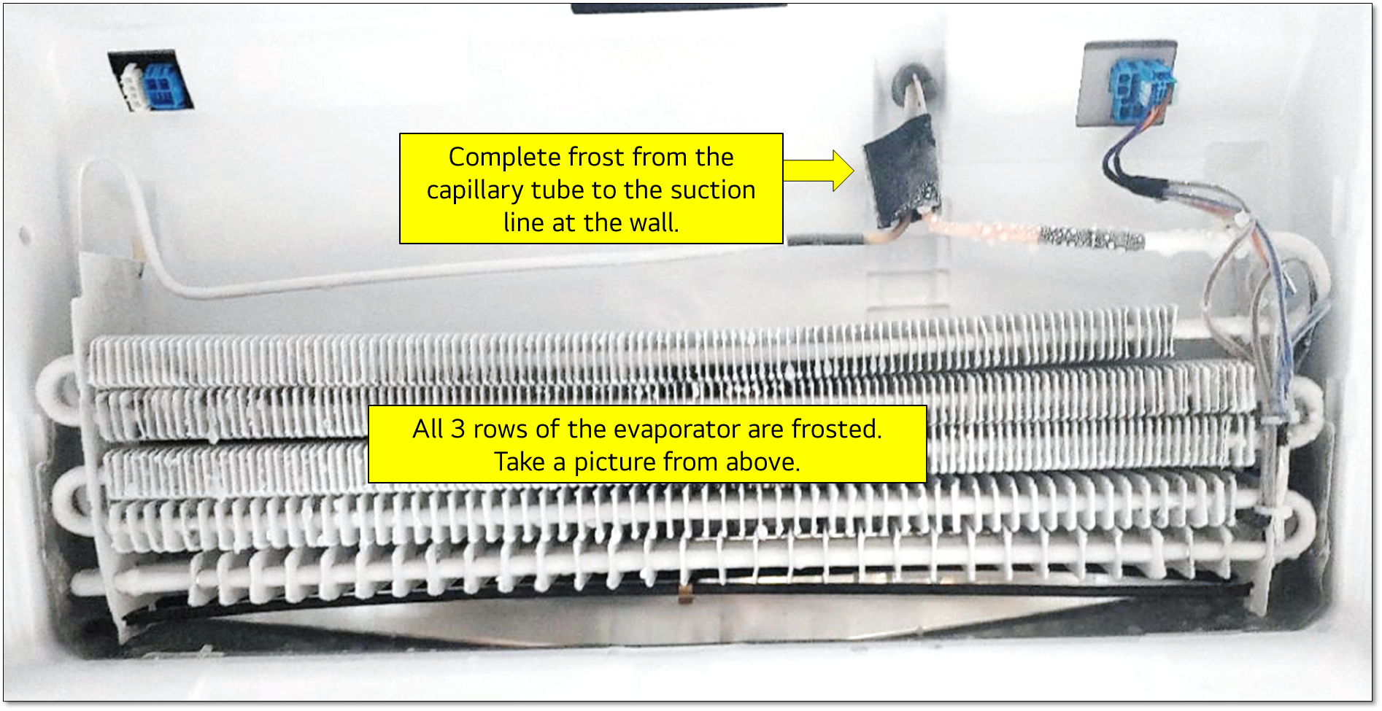
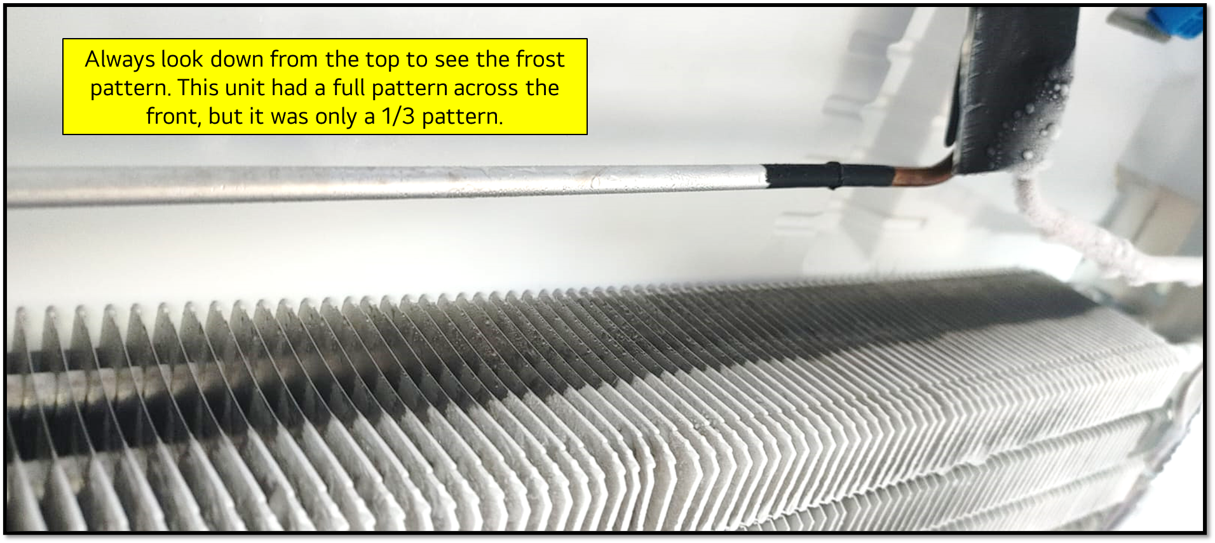
5. Visually inspect evaporator frost patterns
Defrost issues can cause poor cooling issues.
A complete frost pattern is from inlet to outlet and should be also be checked from front to back, all rows should be frosted.
Partial or no frost pattern indicate a sealed system issue, provided the compressor is running with proper voltage.
Look for evidence of corrosion, un-even discoloration, UV Dye (if present), areas of rust or pitting especially near the argon weld, indicating a leak.

Slide 15
6. Tap sealed system and evaluate pressures.
Keep in mind a sealed system failure can have a multiple of these 3 issues.
What caused the compressor to fail?
Always replace the compressor, drier and condenser when contamination is found.
Always verify refrigerant type on the model tag.
When High Side Leak is diagnosed on units produced prior to 2020, isolation and pressure testing of the Yoder Loop should be performed.
Systems with inefficient compressors:
  Replace the compressor and dryer
  Replace the condenser and refrigerator evaporator (if leaks or contamination is found)
  Pressure test the Yoder loop for leaks
  Flush the Yoder loop
For Yoder loop RA Submission TCC requires
  Internal temps
  Voltage/Amperage to Compressor
  Freezer frost pattern inspection/evaluation w/pic.
  High/Low Side run pressures
  Equalization time/pressure

Slide 16
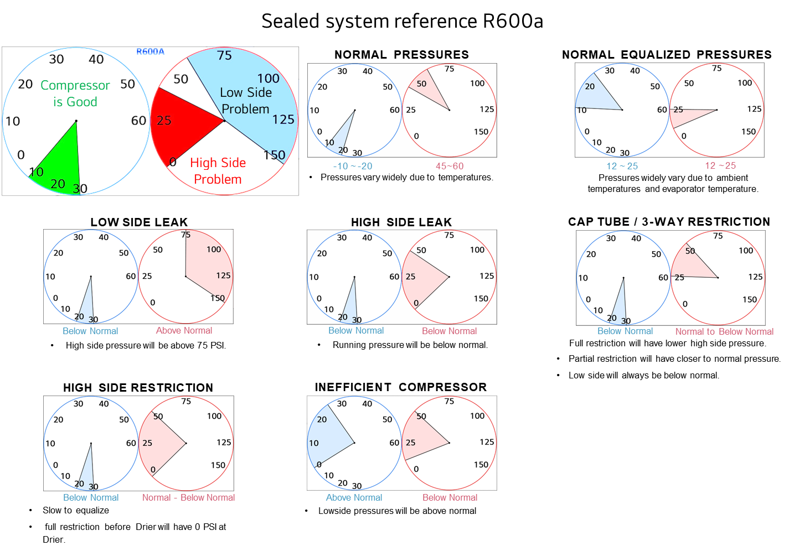
6. Tap sealed system and evaluate pressures.

Slide 17
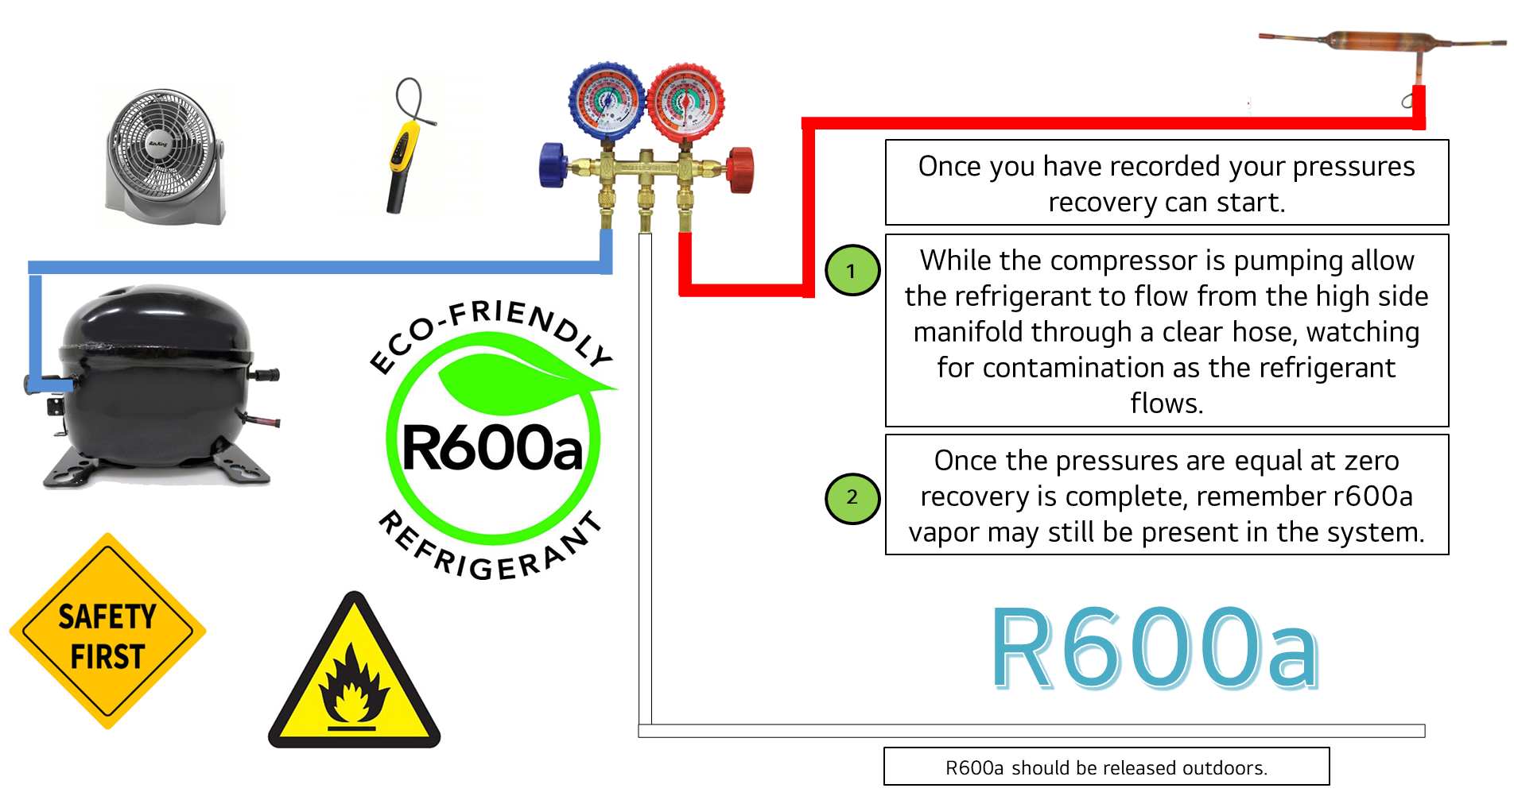
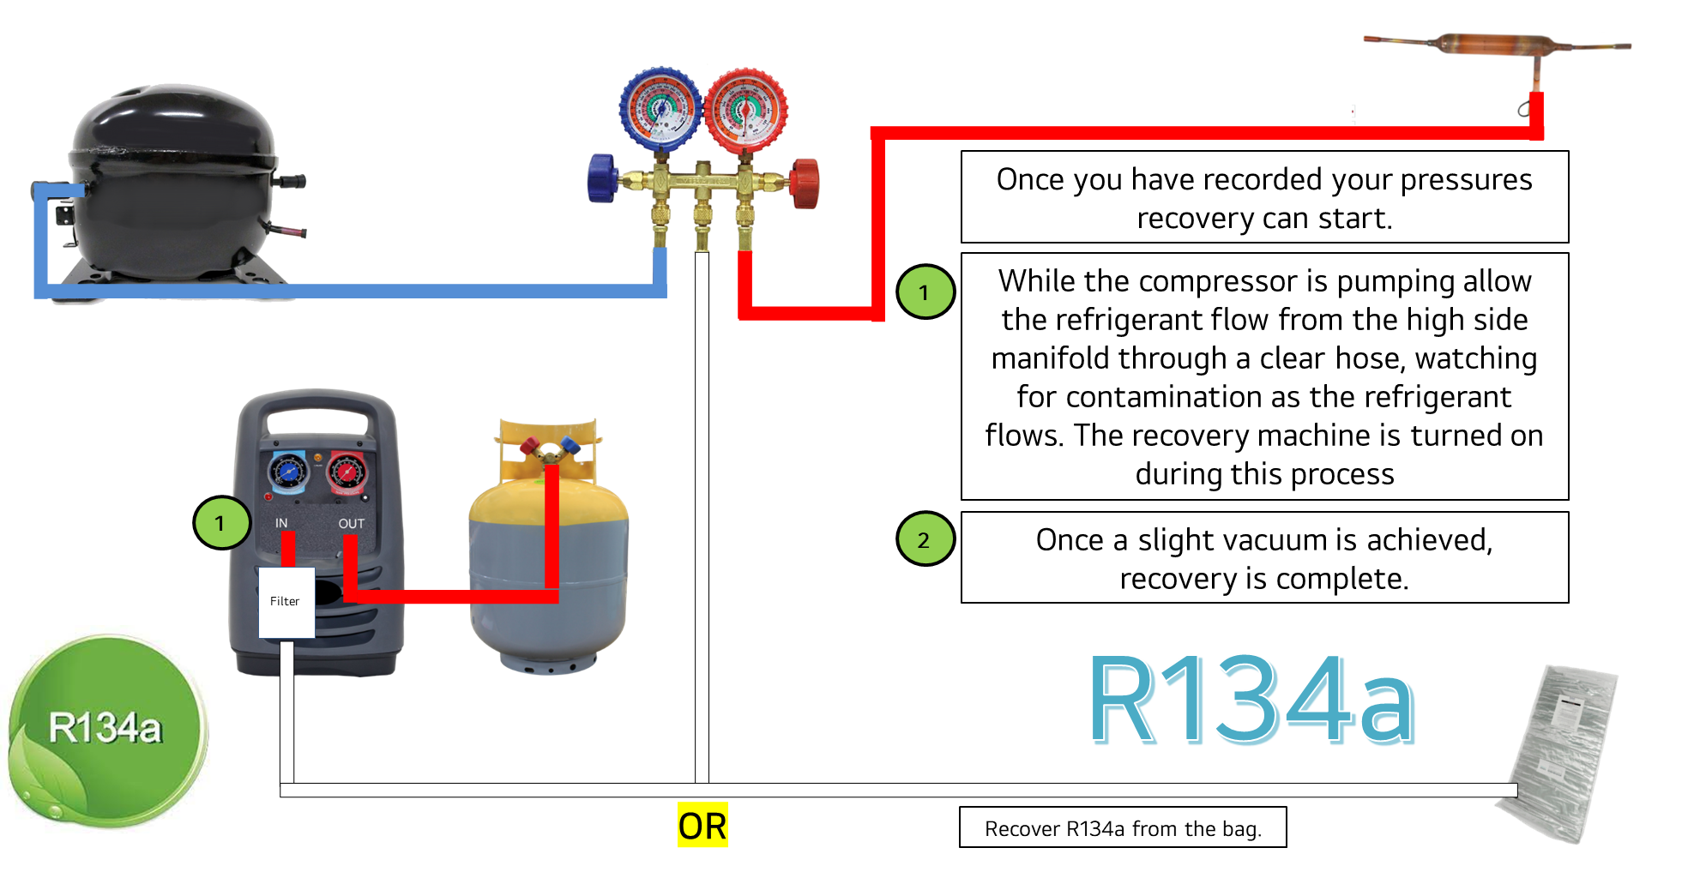
7. Recover and disassemble the sealed system.
Prior to recovery
When a leak is suspected see if you can locate it prior to disassembly
  High side leak
    Add refrigerant to the system to restore normal pressures
    Stop the condenser fan which will increase high side pressures
    Sniff or bubble check all high side joints/components
  General pressure test
    Remove the refrigerant and then add nitrogen to test for leaks in system
After Recovery
Remove the compressor, thinking ahead about how you will reconnect pipes with LokRings.
Clean paint with sandpaper prior to cutting and plan your cuts to help reassembly.
Cut the compressor stub close to the compressor so the 8mm-8mm LokRing can be utilized.
Units made before 2020 should have the Yoder pressure tested for integrity .

Slide 18
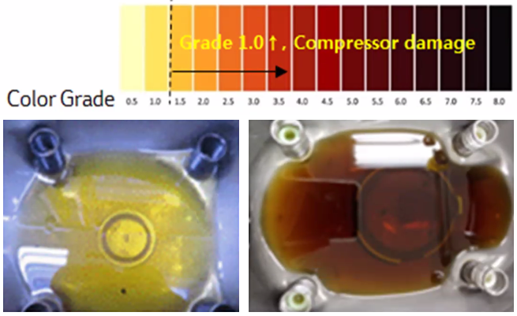
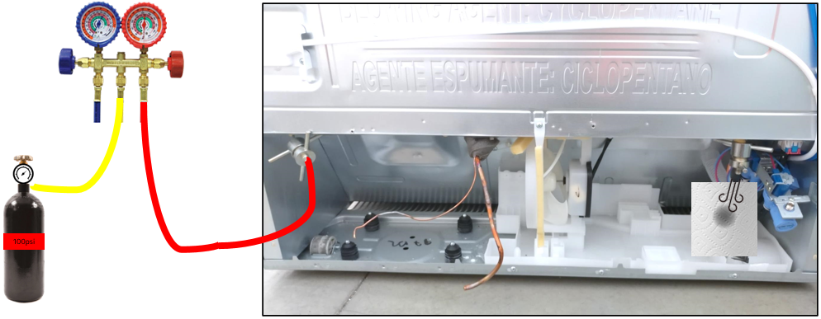
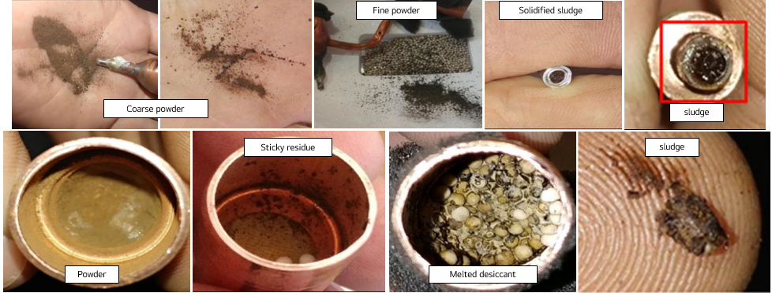
8. Inspecting internal tubing for contamination
Check for contamination
  Send 100 psi nitrogen through the Yoder loop from the drier side of the Yoder loop, looking for contaminations to exit from the Yoder loop near the compressor.
Dark oil indicates contamination.
If the oil is dark replace all the coils and liquid flush all internal tubing.
Tap the drier Yoder side on a paper towel looking for contaminants.

Slide 19
9. Flushing and checking pipes for flow.
Any thing that impedes the flow of refrigerant will create a cooling problem.
Contamination left behind, may collect and create a restriction, after the repair, the refrigerant will “clean” the system as the unit cools.
Cap tube/tubes
  Cap tubes may restrict due to
    Kinks
    Poor cutting of the cap tube / copper deformed due to dull cap tube cutters
    Desiccants and debris
  To check a dual evaporator unit, you must use the 3-way valve jig.
    Always set the 3-way jig to “All” when finished
    Reconnect the factory harness.
  Utilize RX-11 to clean the cap tubes.
  Verify flow by sending nitrogen thru the cap tube and then close the manifold and watch the needle drop.
  If the cap tube is open and clean move forward with the reassembly
  If the cap tube can not be cleaned it should be replaced.
Yoder Loop
  Utilize RX-11 to clean the Yoder loop, verify cleanliness with nitrogen afterwards.
RX-11 Facts
  Must uses protective gloves (Grainger 60HR15)
  Must wear Impact resistant goggles (Grainger 3RYH4)
  Does not evaporate with out vacuuming.
  Should NOT be connect to any valve or tee fitting allowing RX-11 and nitrogen to flow through one setup, use the valve and hose included in the kit, and disconnect before purging with nitrogen.

Slide 20
10. Reassembling the sealed system checking for self inflected restrictions.
Assemble in an order that allows you to test as you install.
  Testing as you go allow you to more easily track down a self inflected restriction.
  Evaporator if needed
    Once you verify your cap tube is open and free flowing with out restrictions install the evaporator.
    After the evaporator has been installed, check for nitrogen flow through the cap tube and back to the suction line.
    If flow is normal move on to the next part if flow is compromised fix the problem and retest.
  Condenser if needed
    Once the Yoder is verified clean, install the condenser to Yoder loop.
    Verify flow through the condenser using nitrogen from the Yoder (Drier side) to the compressor end of the condenser.
    If the there is no blockage move forward with installing the compressor.
  Compressor
    Install the compressor.
  Drier
    Install the drier.
Once all the components are installed move on to testing the complete system using the final flow test.

Slide 21
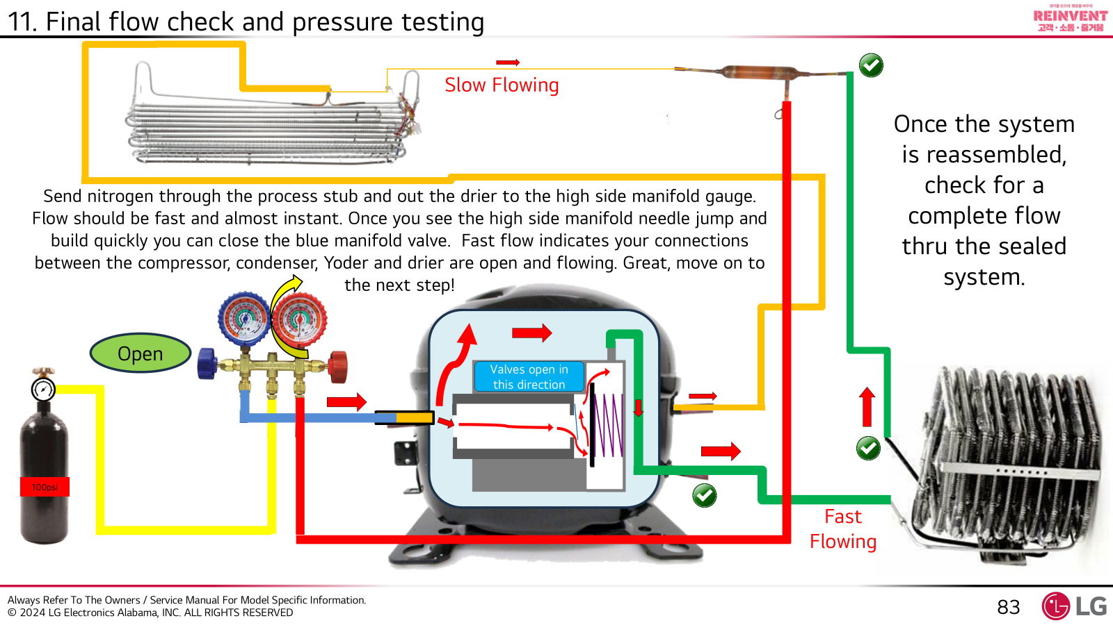
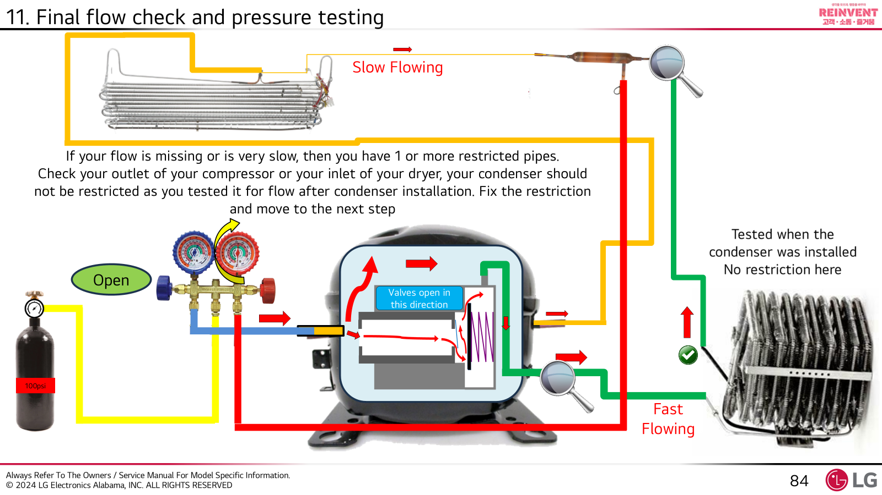
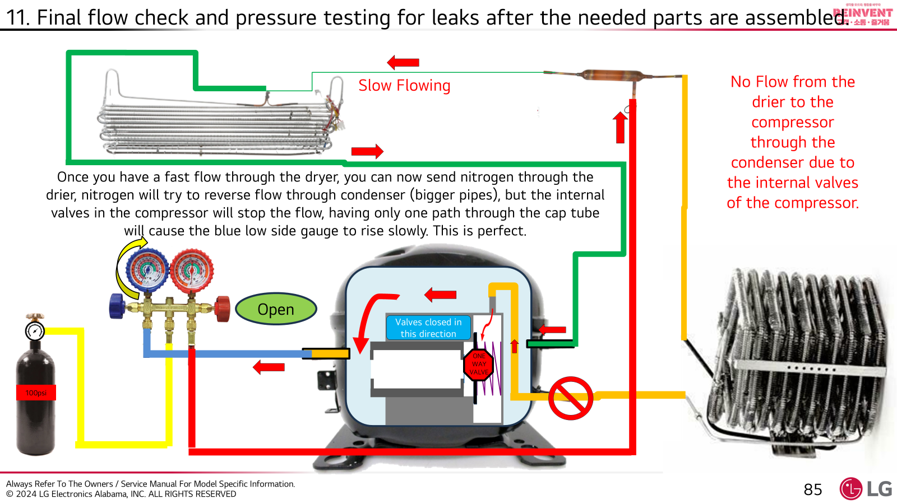
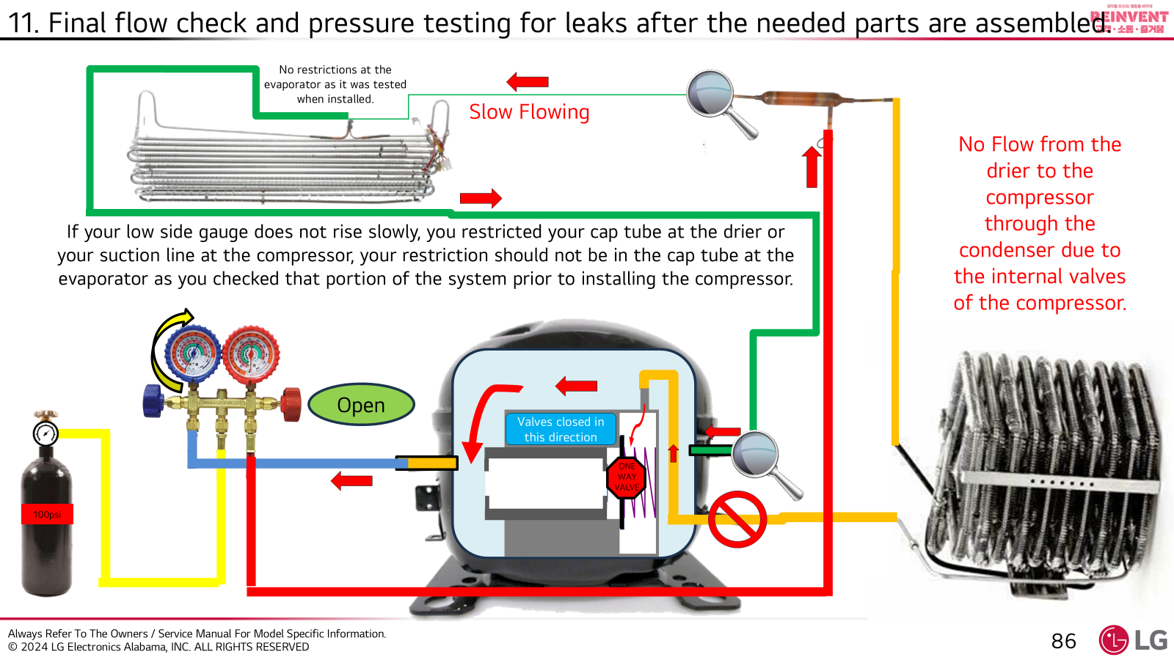
11. Final flow check and pressure testing
Once the unit is completely reassembled, we need to take a few minutes and verify we did not miss a restriction or cause one while assembling the sealed system.
If the nitrogen can flow from the compressor to the drier and then from the drier to back to the compressor, then the refrigerant can also flow, and as long as the liquid refrigerant changes to a gas at the evaporator and then it will pick up heat and bring it to the condenser. The unit will cool!
1
2
3
4

Slide 22
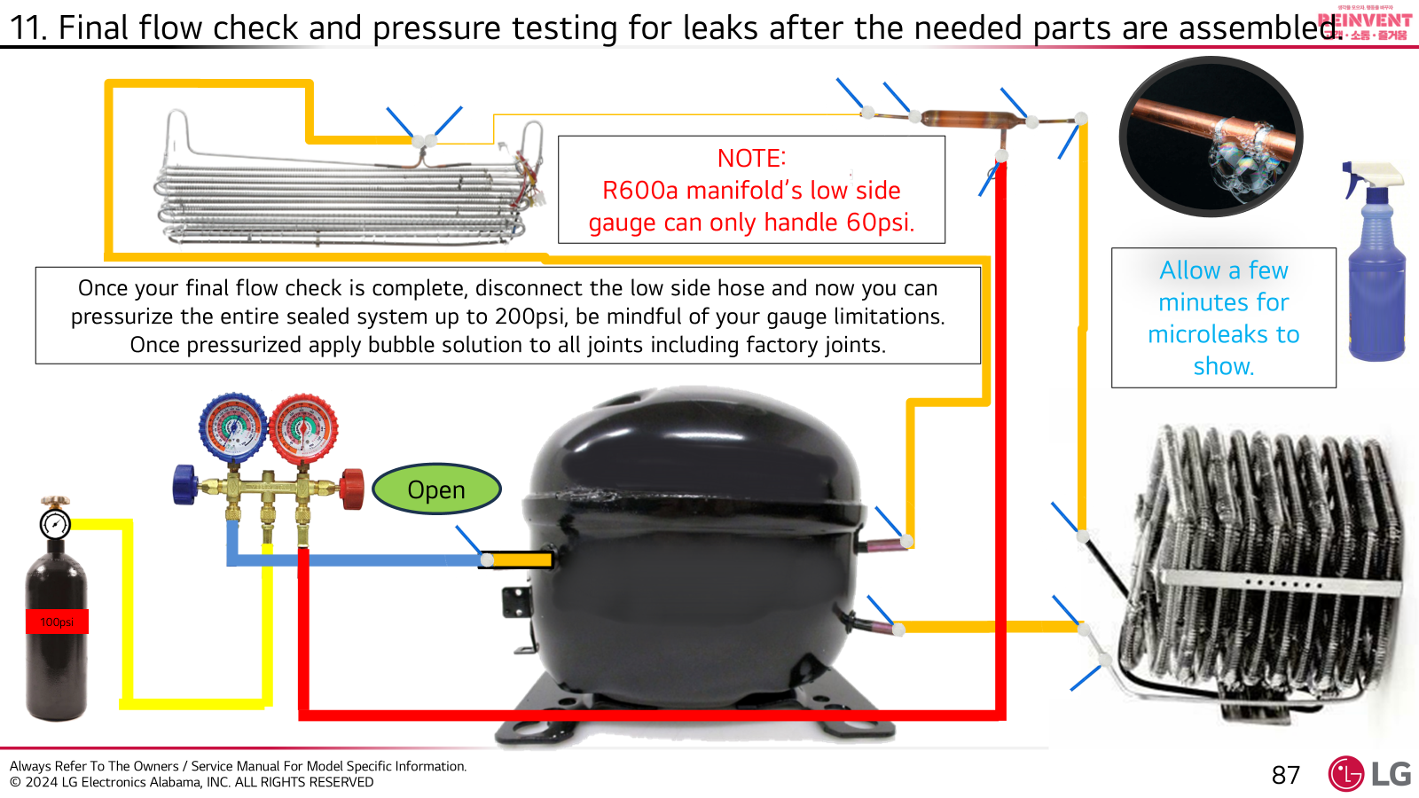
11. Final flow check and pressure testing
Leak Check
  Apply leak detection fluid to all joints including factory joints.
  Lokrings should be checked on both ends and the center as well.
  Allow a few minutes and check for signs of leaks
  If leaks are found correct and retest.

Slide 23
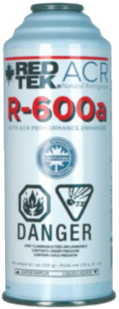
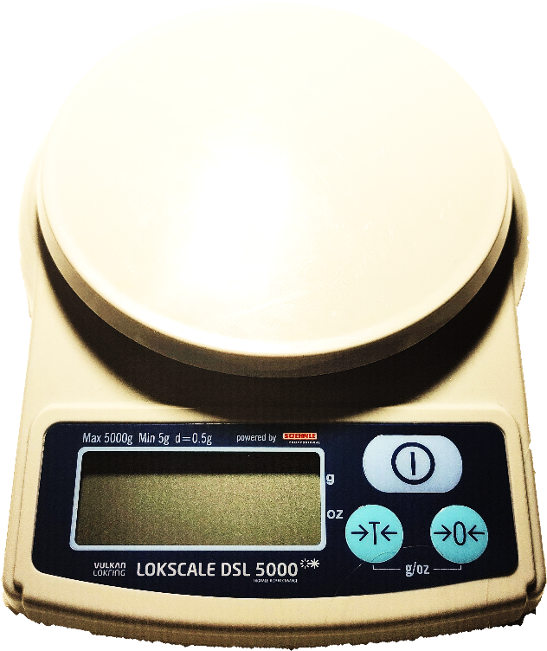
12. Vacuum and recharge.
151-153g New
Best practices for preparing your charge.
Always release extra R600a outdoors.
Always weigh the can before using to verify it is full. (approx. 152g)
Draw a circle around a can, always place the can in the circle, so measurements are consistent.
Scale should be powered on prior to applying weight to the scale, zero out if needed.
Scale should be on a solid level surface.
Release R600a as a liquid when large amounts need to be removed.
Release R600a as a gas slowly when small amounts are needed to removed while on the scale, close the valve when the target is reached.
Do not remove large amounts of R600a as a vapor, the can may become cold and condensation will form on the can, causing an inaccurate reading.

Slide 24
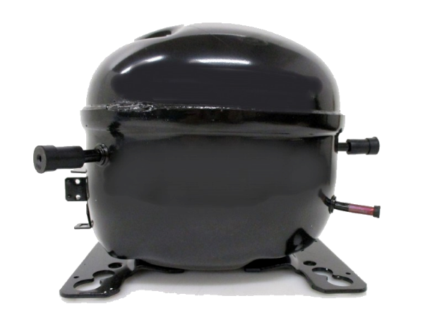
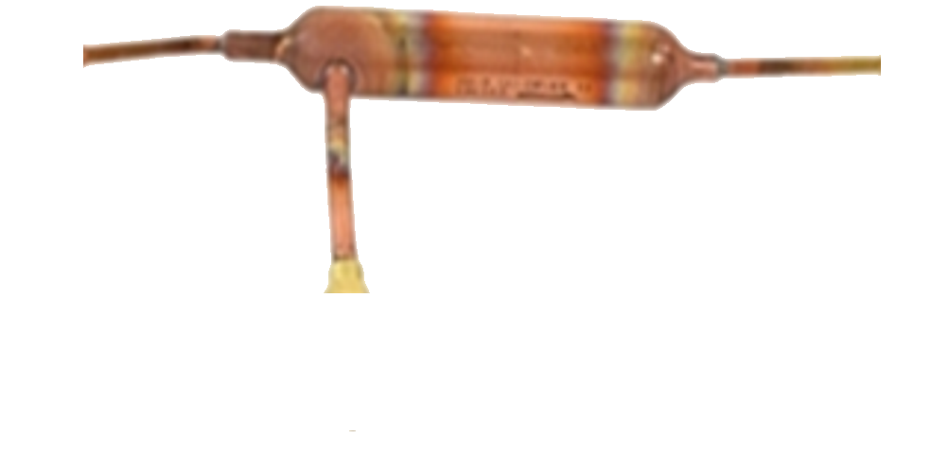
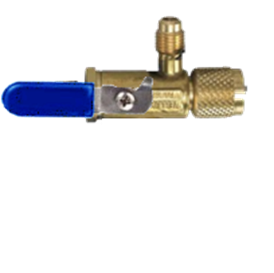
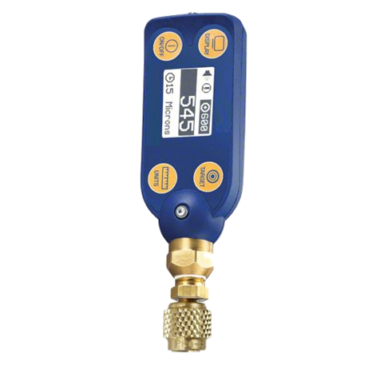
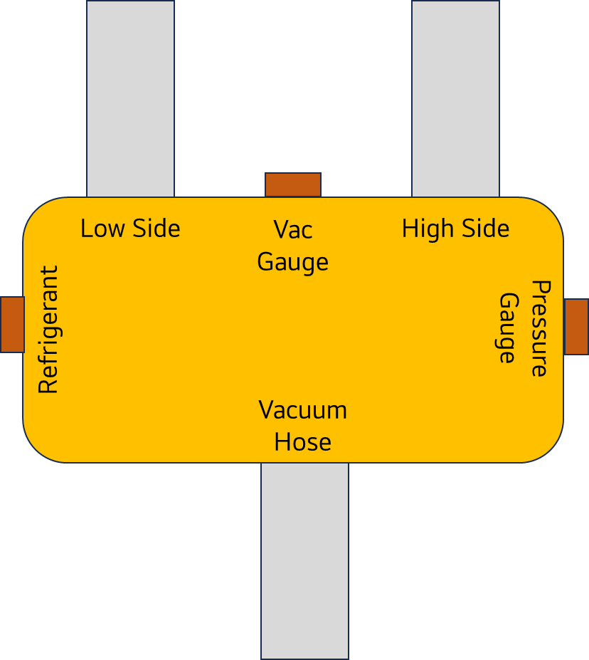
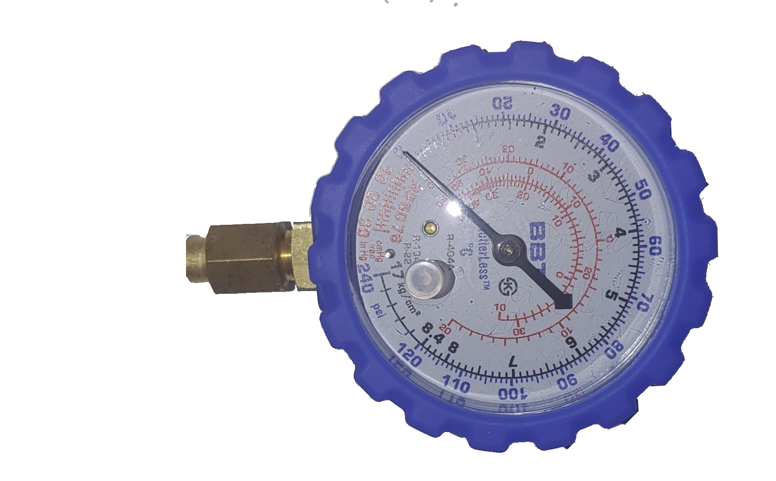
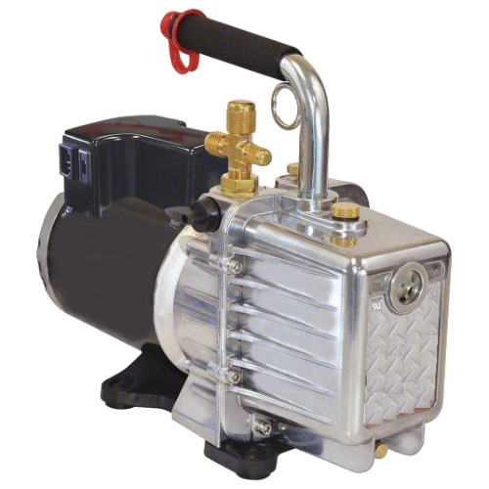
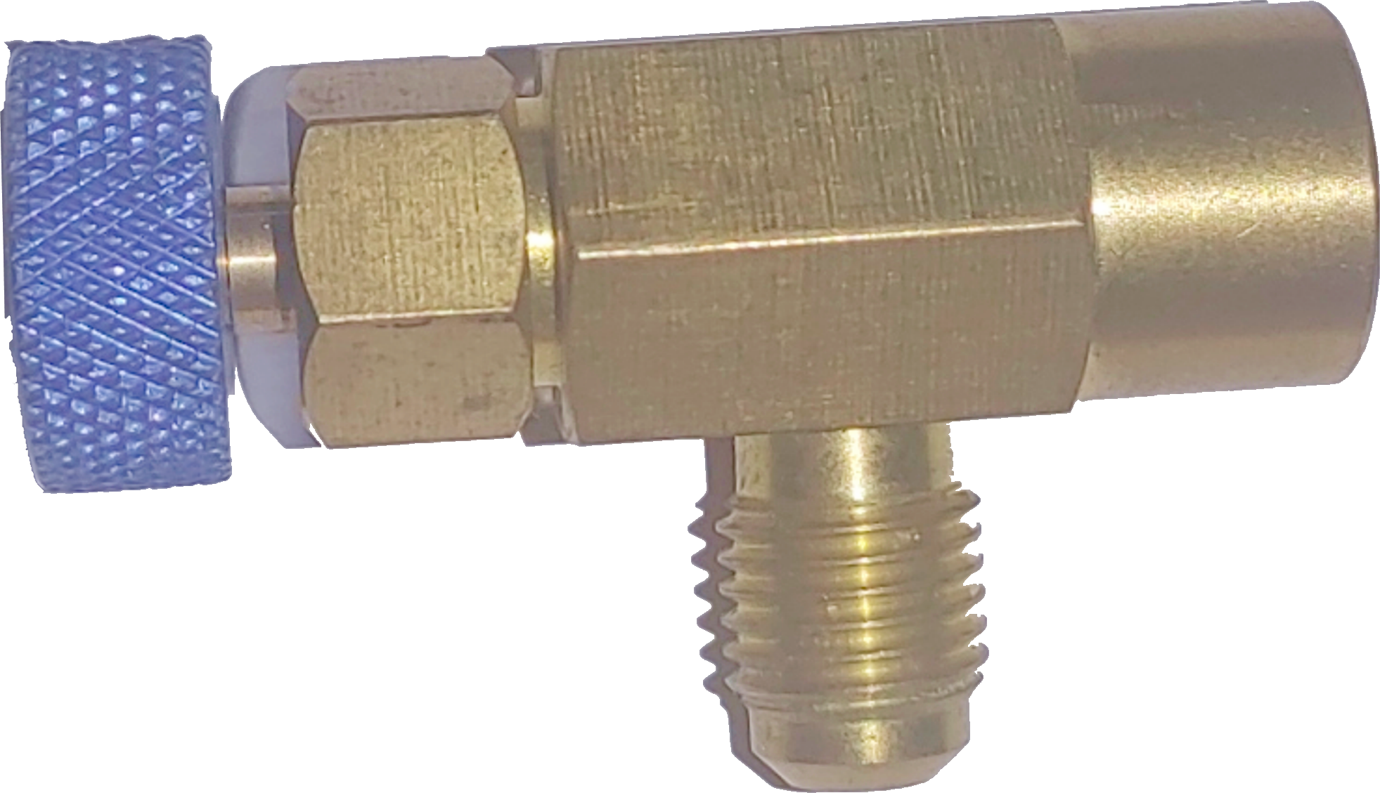
12. Vacuum and recharge.
Setup for the vacuum jig

Slide 25
Vacuum Block Setup Step by Step
Install a core removing tool to the compressor and dryer and close the hand valves on both core removing tools. (avoid rotating the LokRing on the process stub).
Connect the red and blue block hoses to the core removing tools and close both valves on the block.
Install the blue gauge on the “Pressure Gauge” port.
Install the micron gauge on the “Vac Gauge” port.
Install the black hose to the vacuum pump and the “Vacuum Pump” port close the hand valve.

Slide 26
Vacuum Block Start-up Step by Step
Power on your micron gauge, and then power the vacuum pump.
Slowly open the “Vac Gauge” port valve and observe the micron/pressure gauge, both should show a vacuum, allow the pump to pull a deep vacuum on the block, this allows you to verify your seals and connections are tight, verify micron gauge operation
Slowly open the red “High Side” hand valve on the block, your microns should jump but pull down again shortly after.
Slowly open the blue “Low Side” hand valve on the block, your microns should jump but pull down again shortly after.
Slowly open the core removing tool hand valve at the dryer, the sound of the pump should change, and the microns will jump up, once the pump starts quiets down,
Slowly open the core removing tool hand valve at the compressor just enough for the pump to change how it sounds, and the microns will jump up.
  Opening the valve slightly till we hear the pump change allow the pump to pull the non condensables slowly leaving the oil behind, keeping your block clean and oil free.
  Occasionally bump/agitate the compressor to help release trapped non condensables
Prepare the can of R600a outside, by releasing excessive refrigerant from the can, until the desired charge is left in the can.
Connect the charging hose and refrigerant to the block, the microns will increase, but this will not last long .
Observe your Micron gauge once you achieve 500 microns or less start your timer, allow an additional 10 minutes of vacuum time.

Slide 27
Charging
Once 10 minutes of additional vacuuming has past, we can start the charging process
Close the “High Side” hand valve at the block and on the core removing tool.
Install the core into the dryer and remove the core tool. If your microns begin to rise your core is not sealing in the dryer process valve. (correct and re-vacuum if needed)
Close the “Vacuum Hose” hand valve on the block and shut your pump down.
Hold the can upside down and open the valve on the can, allow the liquid refrigerant to flow into the charging block.
  You will see the pressure gauge rise to the positive side as the refrigerant fills the block.
  The “Low Side” valve remains open as does the core removal tool hand valve on the compressor process stub
Once the refrigerant stops flowing, activate the power strip turning the refrigerator on, and active LQC mode if available.
Once the compressor starts to run, the refrigerant should be pulled into the compressor from the block and can.
Once the pressure gauge on the block shows 5” in a vacuum you can now start to remove the charging block, by installing the core in the compressor process stub once the core is in you are done charging.
  Verify you have heat on the outlet of the compressor.

Slide 28
13. Update compressor software.
Always check bulletins for update information.
Also verify if any other updates are required (Craft Ice Maker)
14. Finishing the repair.
    Check controls.
      Check the temperature settings.
      Check for hidden error codes.
        Critical errors will appear in hidden errors long before they display.
    Be proud.
      Set correct expectations.
        24 hours to cool.
        Ice after 24hours.
        Craft ice may take 4-5 days to produce.
      Appliance use and care.
        Explain to the customer to open the freezer door 100% weekly to help prevent ice build up on the rails.
        Advise to change filters every 6 months.
        Offer water/air filters
        Advise using ThinQ
      Leave your contact info.
        Thank the customer for allowing you to service their unit.
        Leave your contact info of future communications.

Slide 29
15. MAKE GOOD NOTES - They Help Everyone!
    Notes Should include
      Unit temperatures.
      Hidden error codes
      Blink codes
      Voltages
        Compressor
        House/polarity
      Pressures
      Customers complaint
      Your assessment
      Your course of repair
      parts installed
Arrive at home, unit has several dents on the freezer door, see pics attached. Customer complains the unit is not cooling, the unit is at 50R and 20F. House voltage 116v polarity is good, Comp 140v .4 amps, found cap tube restriction after the dryer. Replaced comp, drier, evap, cond and cap. Flush system, vacuumed and recharged 52g or r600a. Allow 24 hours to cool.

